Slide 1


Service Level Agreement based Allocation of Cluster Resources:
Handling Penalty to Enhance Utility
Chee Shin Yeo and Rajkumar Buyya
Grid Computing and Distributed Systems (GRIDS) Lab.
Dept. of Computer Science and Software Engineering
The University of Melbourne, Australia
http://www.gridbus.org

Slide 2
Problem
Providing a service market via Service-oriented Grid computing
  IBM’s E-Business on Demand, HP’s Adaptive Enterprise, Sun Microsystem’s pay-as-you-go
  Grid resources comprise clusters
Utility-driven cluster computing
  Service Level Agreement (SLA): differentiate different values and varying requirements of jobs depending on user-specific needs and expectations
  Cluster Resource Management System (RMS) need to support and enforce SLAs

Slide 3
Proposal
Current Cluster RMSs focus on overall job performance and system usage
Using market-based approaches for utility-driven computing
Utility based on users’ willingness to pay
Utility varies with users’ SLAs
  Deadline
  Budget
  Penalty

Slide 4
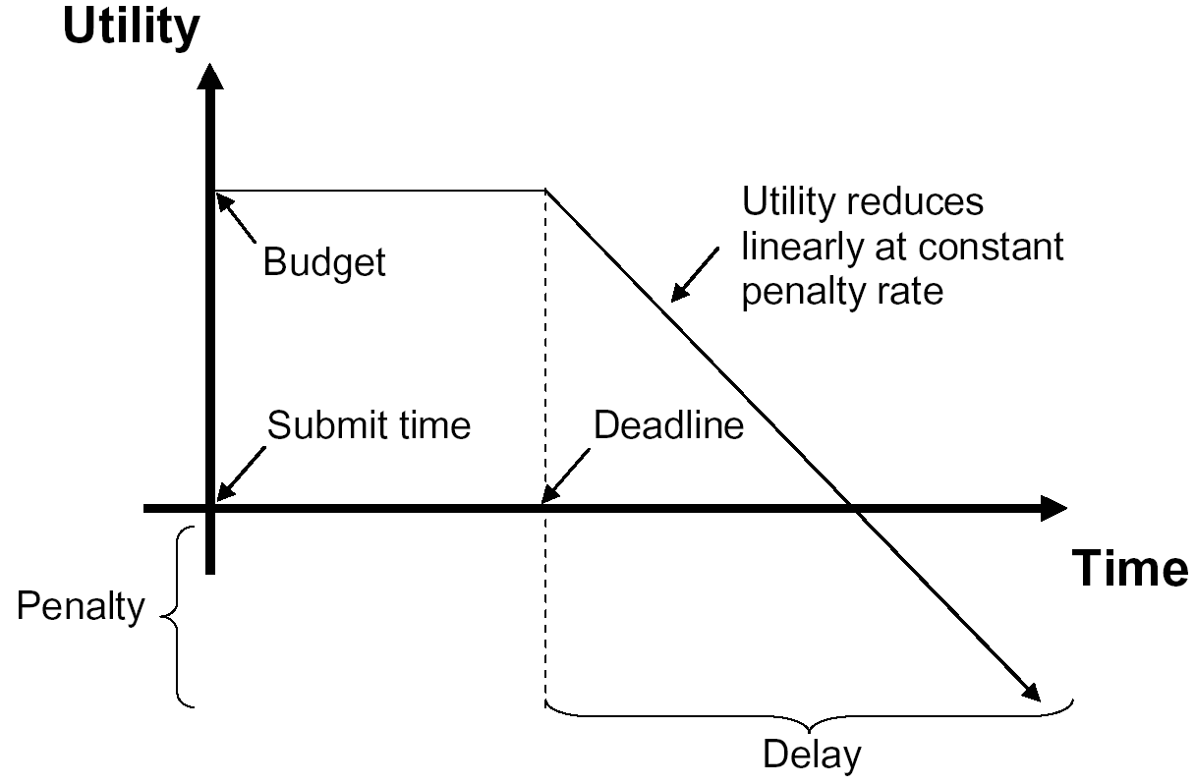
Impact of Penalty Function on Utility

Slide 5
Service Level Agreement (SLA)
Delay
  Delay = (finish_time – submit_time) - deadline
Utility
  Utility = budget – (delay * penalty_rate)
  No Delay
    Utility = Budget
  Delay
    0 < Utility < Budget
    Utility < 0
LibraSLA – considers risk of penalties
  Proportional share
  Considers job properties
    Run time
    Number of processors

Slide 6
LibraSLA
SLA based Proportional Share with Utility Consideration
  Users express utility as budget or amount of real money
  Focuses on resource allocation (not elaborating on other market concepts such as user bidding strategies or auction pricing mechanisms)
  Users only gain utility and pay for service upon job completion (may be penalty)

Slide 7
LibraSLA
  Estimated run time provided during job submission is accurate
  Deadline of a job > its estimated run time
  SLA does not change after job acceptance
  Users submit jobs thru Cluster RMS only
  Cluster nodes may be homogeneous or heterogeneous
  Time-shared scheduling supported at nodes

Slide 8
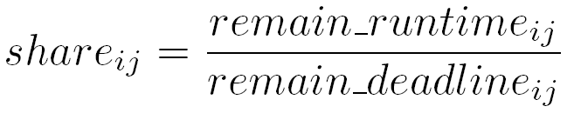
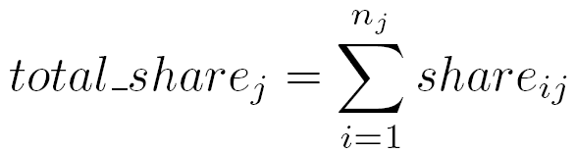
LibraSLA
Proportional Share of a job i on node j
  Deadline and Run time
Total share for all jobs on a node j
  Delay when total_share > maximum processor time of node

Slide 9
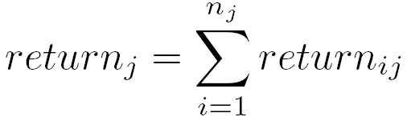
LibraSLA
Return of a job i on node j
  Return < 0 if utility < 0
  Favors jobs with shorter deadlines
  Higher penalty for jobs with shorter deadlines
Return of a node j
  Lower return indicates overloading

Slide 10
LibraSLA
Admission Control (Accept new job or not?)
  Determines return of each node if new job is accepted
  Node is suitable if
    It has higher return
    It can satisfy HARD deadline if required
  New job accepted if enough suitable nodes as requested
  Accepted new job allocated to nodes with highest return

Slide 11
LibraSLA
Determines return of a node
  Determines total share of processor time to fulfill deadlines of all its allocated jobs and new job
  Identifies job with highest return
  Gives additional remaining share to job with highest return (if any)
  If insufficient processor time, only job with highest return and jobs with hard deadlines are not delayed;
  jobs with soft deadlines are delayed proportionally
  Returns of these delays computed accordingly

Slide 12
Performance Evaluation: Simulation
Simulated scheduling for a cluster computing environment using the GridSim toolkit
(http://www.gridbus.org/gridsim)
Notes:
In order to test how effectively libra works or assess its performance we run simulations.
But how do we define acceptable or good performance?
What were optimizing is user satisfaction, so for us, a measure of good performance would be finishing as many jobs as possible within their deadlines in a fixed time period

Slide 13
Experimental Methodology:
Trace Properties
Feitelson’s Parallel Workload Archive
(http://www.cs.huji.ac.il/labs/parallel/workload)
Last 1000 jobs in SDSC SP2 trace
  Average inter arrival time:
  2276 secs (37.93 mins)
  Average run time:
  10610 secs (2.94 hrs)
  Average number of requsted processors:
  18
Notes:
In order to test how effectively libra works or assess its performance we run simulations.
But how do we define acceptable or good performance?
What were optimizing is user satisfaction, so for us, a measure of good performance would be finishing as many jobs as possible within their deadlines in a fixed time period

Slide 14
Experimental Methodology:
Cluster Properties
SDSC SP2:
  Number of computation nodes:
  128
  SPEC rating of each node:
  168
  Processor type on each computation node:
  RISC System/6000
  Operating System:
  AIX
Notes:
In order to test how effectively libra works or assess its performance we run simulations.
But how do we define acceptable or good performance?
What were optimizing is user satisfaction, so for us, a measure of good performance would be finishing as many jobs as possible within their deadlines in a fixed time period

Slide 15
Experimental Methodology:
SLA Properties
20% - HIGH urgency jobs
  HARD deadline type
  LOW deadline/runtime
  HIGH budget/f(runtime)
  HIGH penalty_rate/g(runtime)
  where f(runtime) and g(runtime) are functions representing the MINIMUM budget and penalty rate for the user-specified runtime
Notes:
In order to test how effectively libra works or assess its performance we run simulations.
But how do we define acceptable or good performance?
What were optimizing is user satisfaction, so for us, a measure of good performance would be finishing as many jobs as possible within their deadlines in a fixed time period

Slide 16
Experimental Methodology:
SLA Properties
80% - LOW urgency jobs
  SOFT deadline type
  HIGH deadline/runtime
  LOW budget/f(runtime)
  LOW penalty_rate/g(runtime)
  where f(runtime) and g(runtime) are functions representing the MINIMUM budget and penalty rate for the user-specified runtime
Notes:
In order to test how effectively libra works or assess its performance we run simulations.
But how do we define acceptable or good performance?
What were optimizing is user satisfaction, so for us, a measure of good performance would be finishing as many jobs as possible within their deadlines in a fixed time period

Slide 17
Experimental Methodology:
SLA Properties
High:Low ratio
  Eg. Deadline high:low ratio is the ratio of means for high deadline/runtime (low urgency) and low deadline/runtime (high urgency)
  Deadline high:low ratio of 7
  Budget high:low ratio of 7
  Penalty Rate high:low ratio of 4
Notes:
In order to test how effectively libra works or assess its performance we run simulations.
But how do we define acceptable or good performance?
What were optimizing is user satisfaction, so for us, a measure of good performance would be finishing as many jobs as possible within their deadlines in a fixed time period

Slide 18
Experimental Methodology:
SLA Properties
Values normally distributed within each HIGH and LOW
  deadline/runtime
  budget/f(runtime)
  penalty_rate/g(runtime)
HIGH and LOW urgency jobs randomly distributed in arrival sequence

Slide 19
Experimental Methodology: Performance Evaluation
Arrival delay factor
  Models cluster workload thru inter arrival time of jobs
  Eg. arrival delay factor of 0.01 means a job with 400 s of inter arrival time now has 4 s
Mean factor
  Denotes mean value for normal distribution of deadline, budget and penalty rate SLA parameters
  Eg. Mean factor of 2 means having mean value double that of 1 (ie. higher)

Slide 20
Experimental Methodology: Performance Evaluation
Comparison with Libra
  Assumes HARD deadline
  Selects nodes based on BEST FIT strategy
  (ie. nodes with least available processor time after accepting the new job are selected first)
Evaluation Metrics
  Number of jobs completed with SLA fulfilled
  Aggregate utility achieved for jobs completed

Slide 21
Performance Evaluation:
Impact of Various SLA Properties
Deadline type
  Hard: no delay
  Soft: can accommodate delay (Penalty rate determines limits of delay)
Deadline
  Time period to finish the job
Budget
  Maximum amount of currency user willing to pay
Penalty rate
  Compensate user for failure to meet deadline
  Reflects flexibility with delayed deadline
  (higher penalty rate limits delay to be shorter)

Slide 22
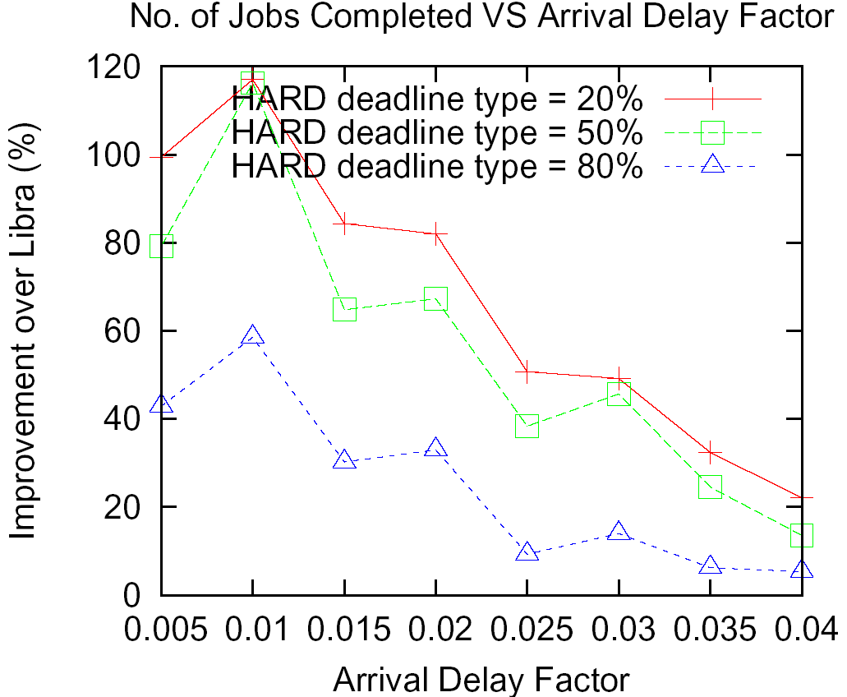
Deadline Type

Slide 23
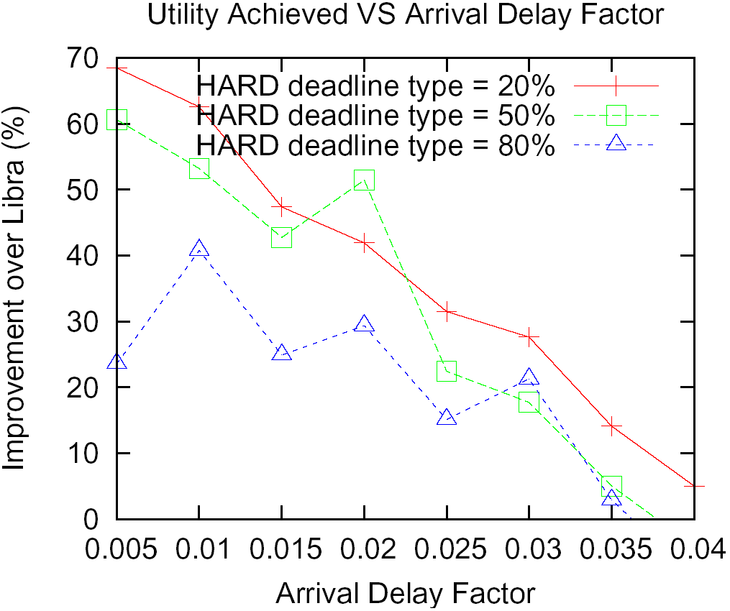
Deadline Type

Slide 24
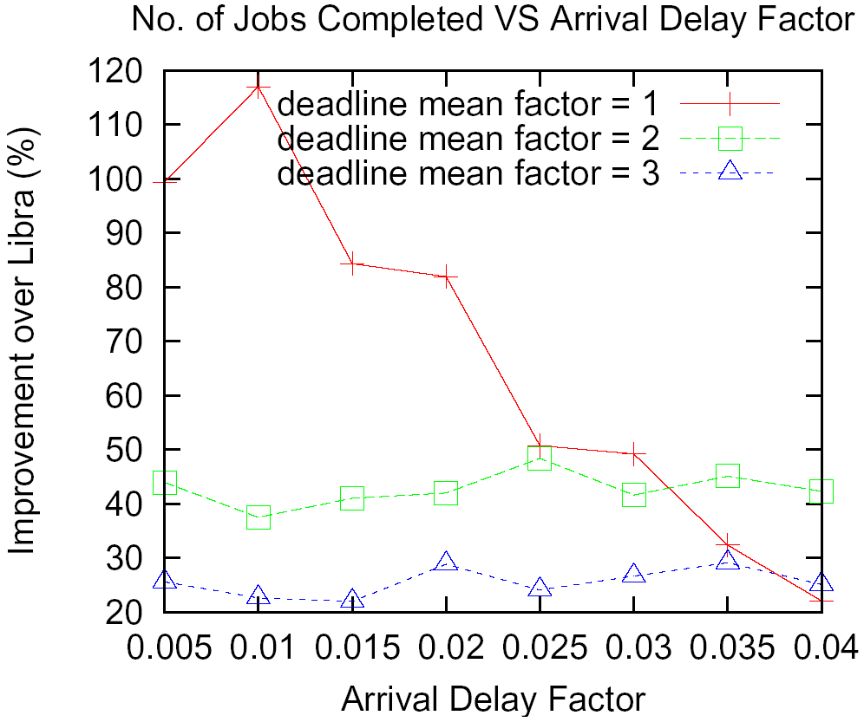
Deadline Mean Factor

Slide 25
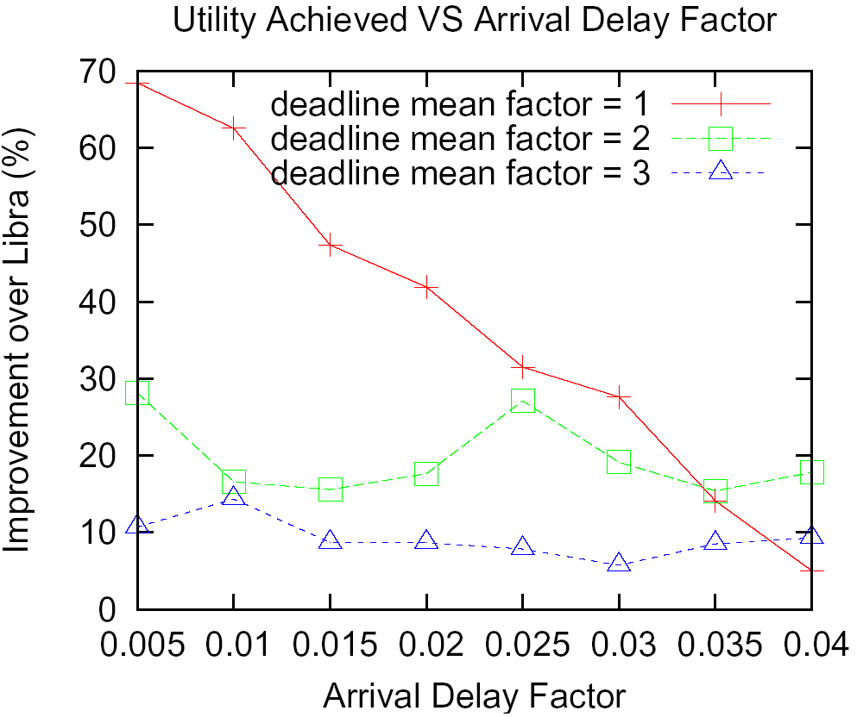
Deadline Mean Factor

Slide 26
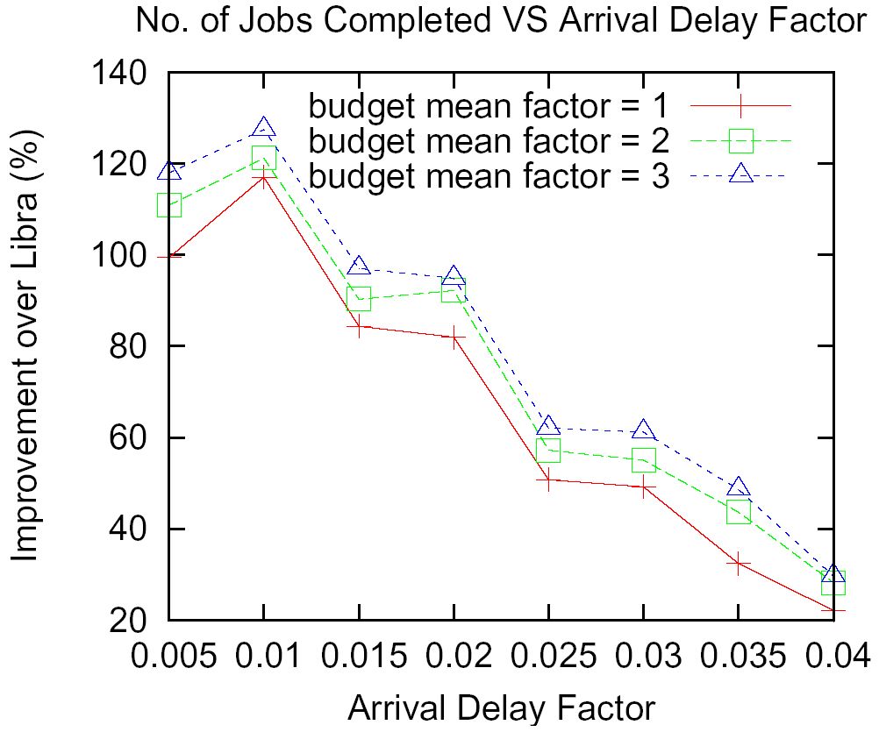
Budget Mean Factor

Slide 27
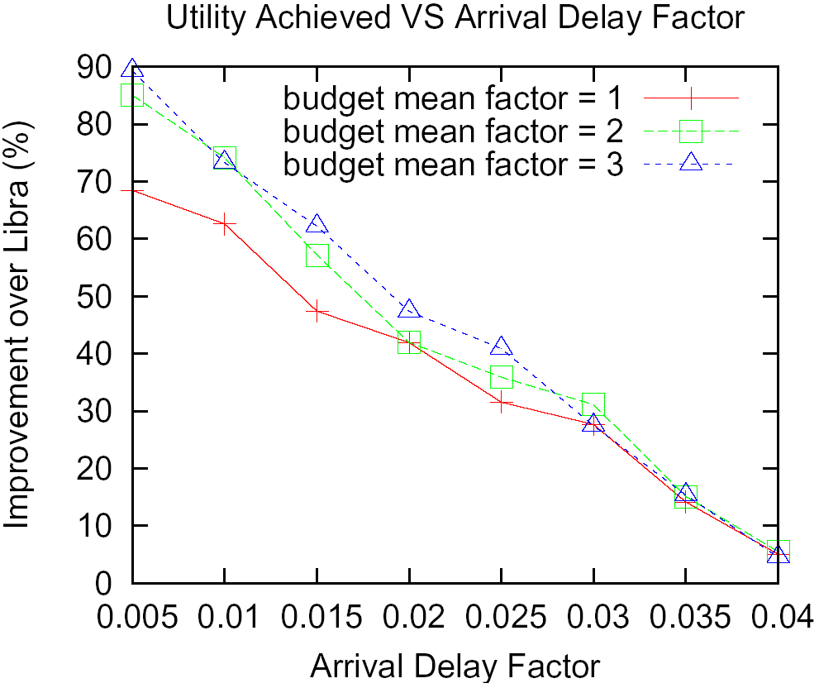
Budget Mean Factor

Slide 28
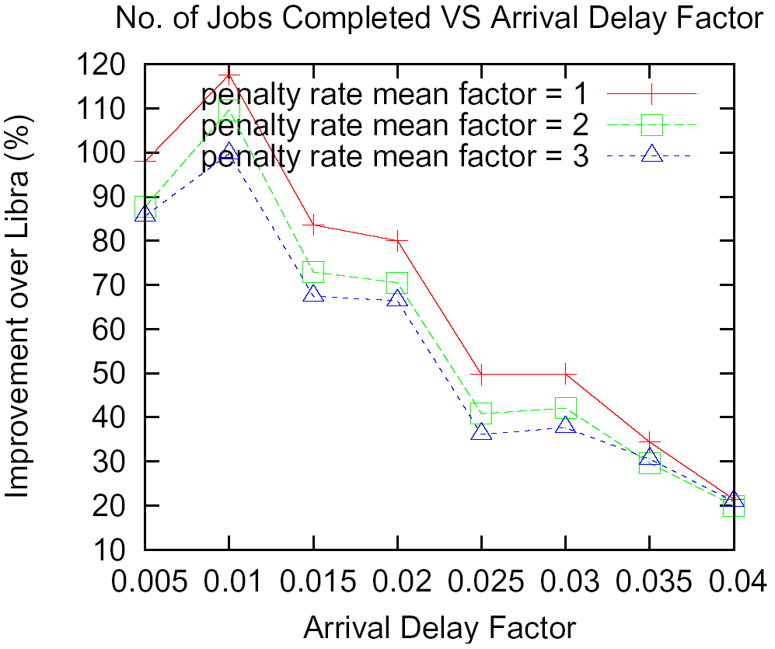
Penalty Rate Mean Factor

Slide 29
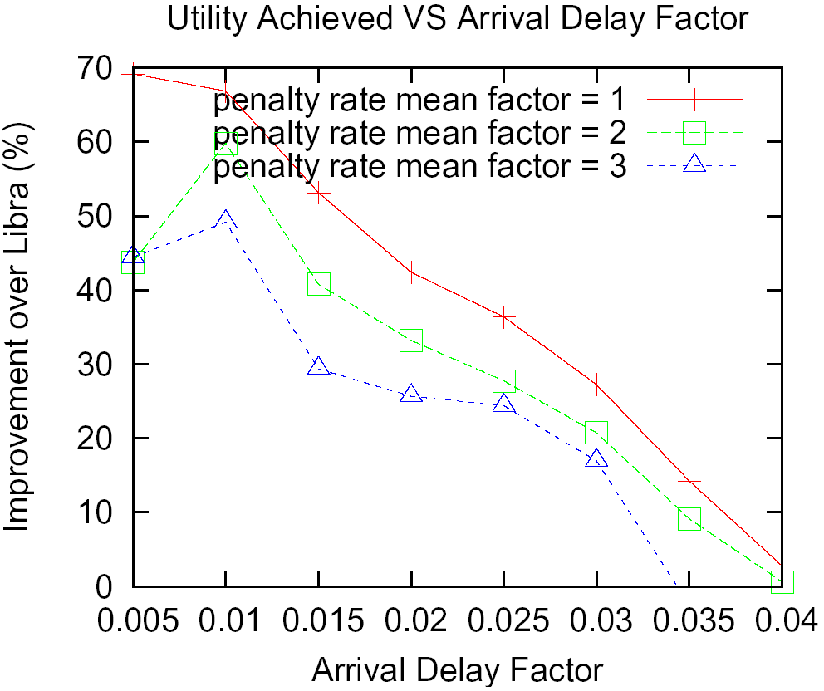
Penalty Rate Mean Factor

Slide 30
Conclusion
Importance of handling penalty in SLAs
LibraSLA
  Fulfill more SLAs thru soft deadlines
  Minimizes penalties to improve utility
SLA with 4 parameters
  (i) Deadline Type (ii) Deadline (iii) Budget
  (iv) Penalty Rate
Need to support
  Utility-driven cluster computing
  Service-oriented Grid computing

Slide 31
End of Presentation
Questions ?

Slide 32
Motivation
Cluster-based systems have gained popularity and widely adopted
  75% of Top500 supercomputers world-wide based on Cluster architecture
  Clusters are used in not only used in scientific computing, but also in driving many commercial applications
  Many Corporate Data Centers are cluster-based systems

Slide 33
Related Work
Existing cluster RMSs
  Condor, LoadLeveler, LSF, PBS, SGE
Advanced Scheduler
  Maui
Bid-based proportional share
  REXEC [Chun B.,2000]
  Tycoon [Lai K.,2004]

Slide 34
Related Work
Cluster-On-Demand [Irwin D., 2004]
  Penalty after deadline instead of runtime
  Priorities job with highest return
QoPS [Islam M., 2004]
  Penalty rate instead of slack factor
  Minimize penalty to improve utility
  Proportional share
Libra [Sherwani J., 2004]
  Soft deadline as well as HARD deadline
  Examines return of accepting new job

